Slide 1


Treasures of Guatemala:
Fray Bartolomé de las Casas and Tikal
www.sowingops.org

Slide 2
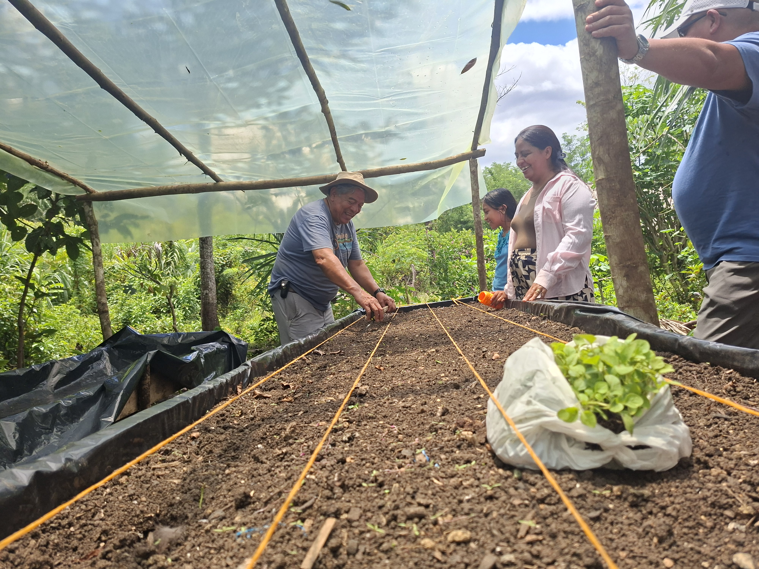
SAVE
THE
DATE
FROM SEPTEMBER 22ND
TO SEPTEMBER 28TH

Slide 3
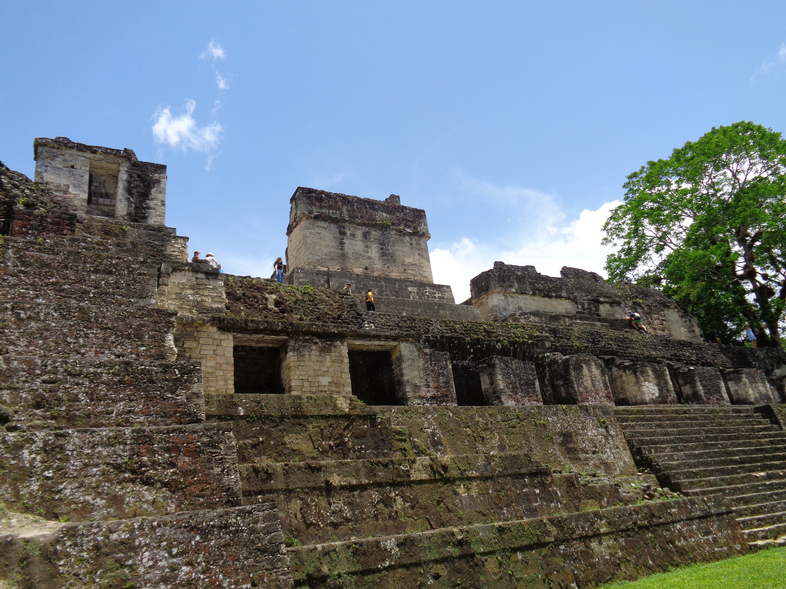
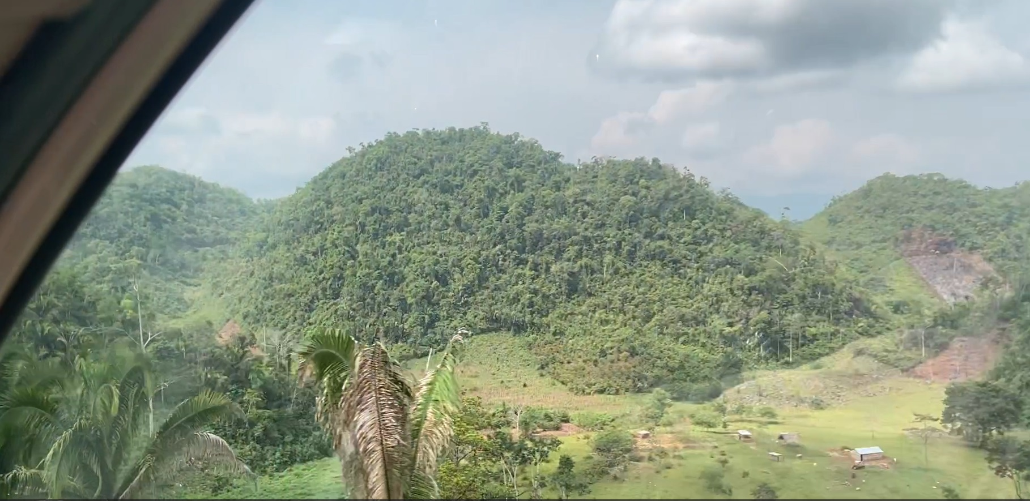
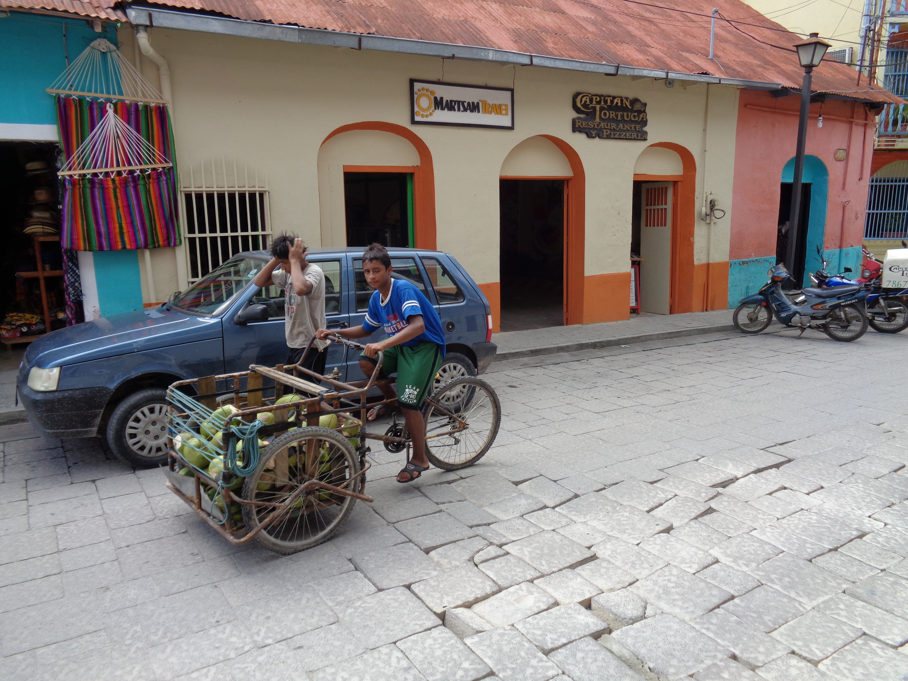
Welcome to Northern Guatemala
Discover the beauty, history, and culture of northern Guatemala.
Destinations that are waiting for you are:
Fray Bartolomé de Las Casas and Tikal

Slide 4
Day 1
September 22
Welcome Day
Transfer from the airport to hotel IN & OUT
(close to the airport)
Meet with the rest
of the group
Includes: Breakfast, Lunch and Dinner

Slide 5
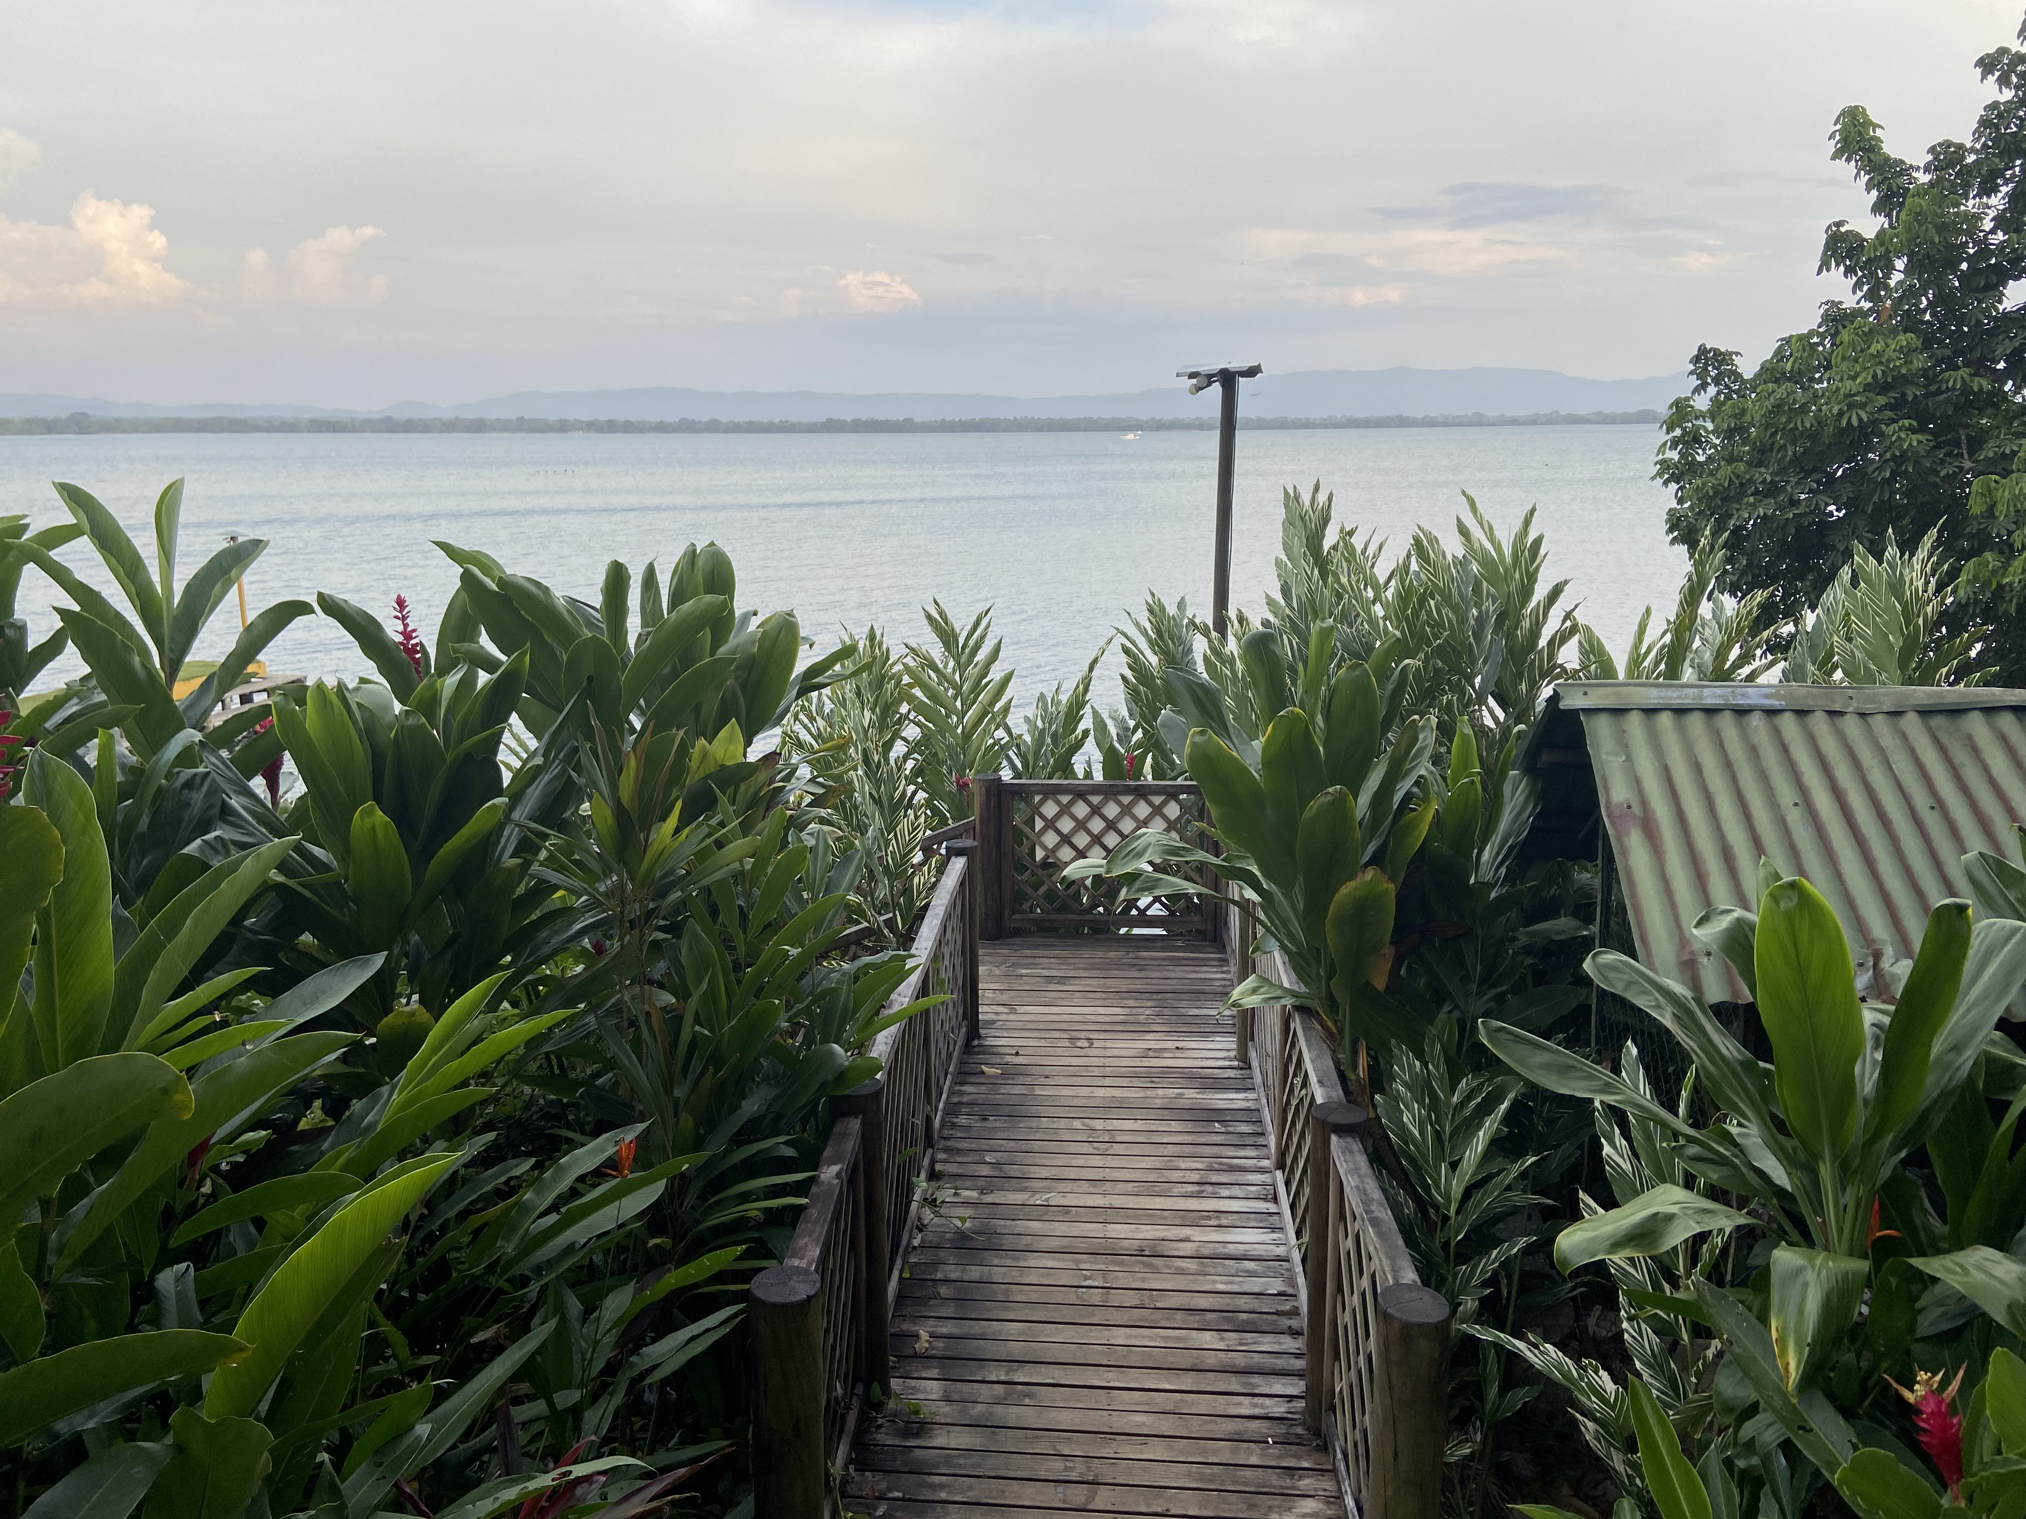
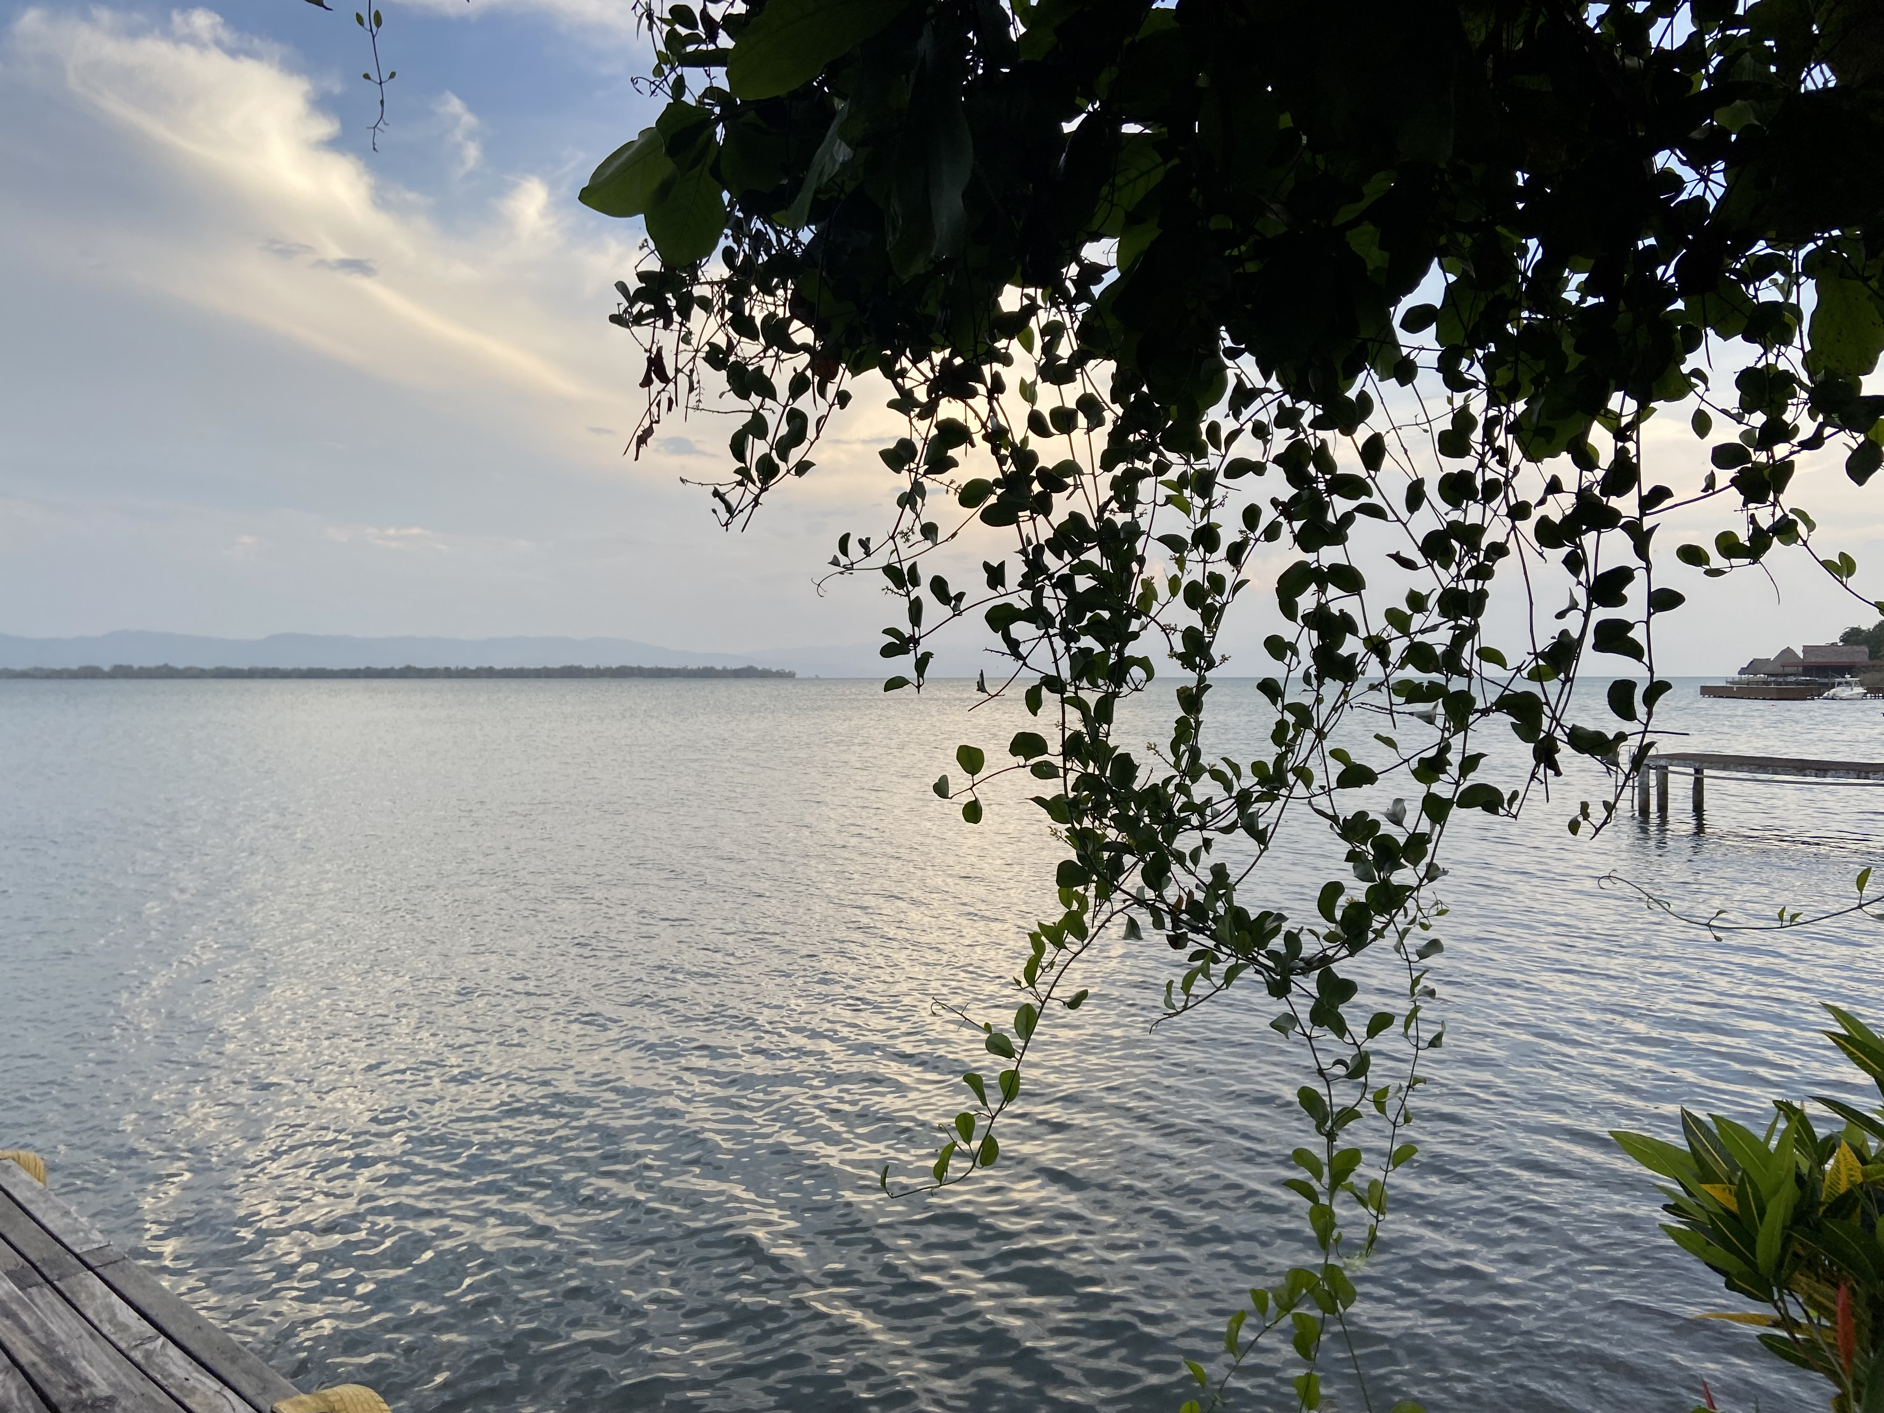
Day 2
September 23
Flight from Guatemala City to Flores
1-hour Flight
and
Transfer to Río Dulce
8-hour transfer
Hotel Viña del Lago
Includes: Breakfast, Lunch and Dinner

Slide 6
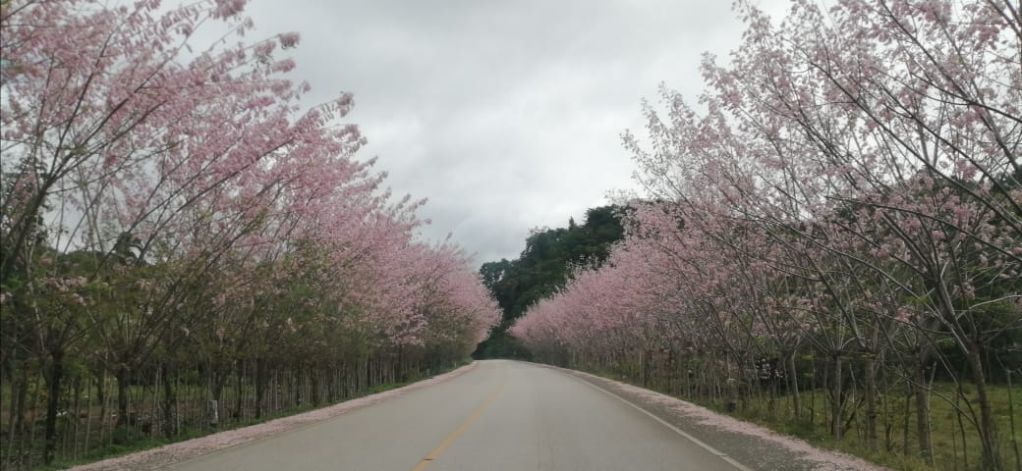
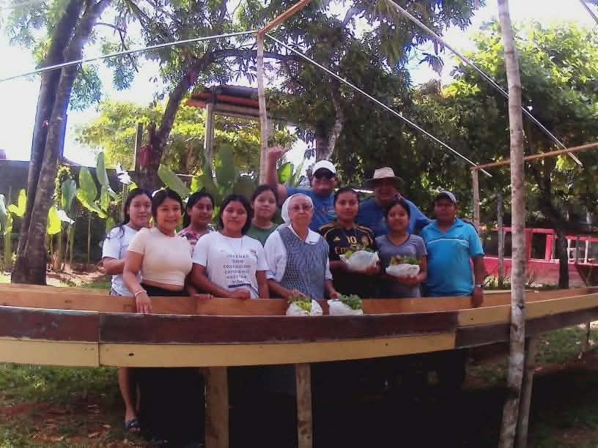
Day 3
September 24
Transfer from Río Dulce to Fray Bartolome de las Casas
3-hour transfer
WORKDAY #1
Transfer from Fray Bartolomé de las Casas to Río Dulce
3-hour transfer
Hotel Viña del Lago
Includes:
Breakfast and Lunch in
Fray Bartolomé de las Casas
and dinner at Viñas del Lago

Slide 7
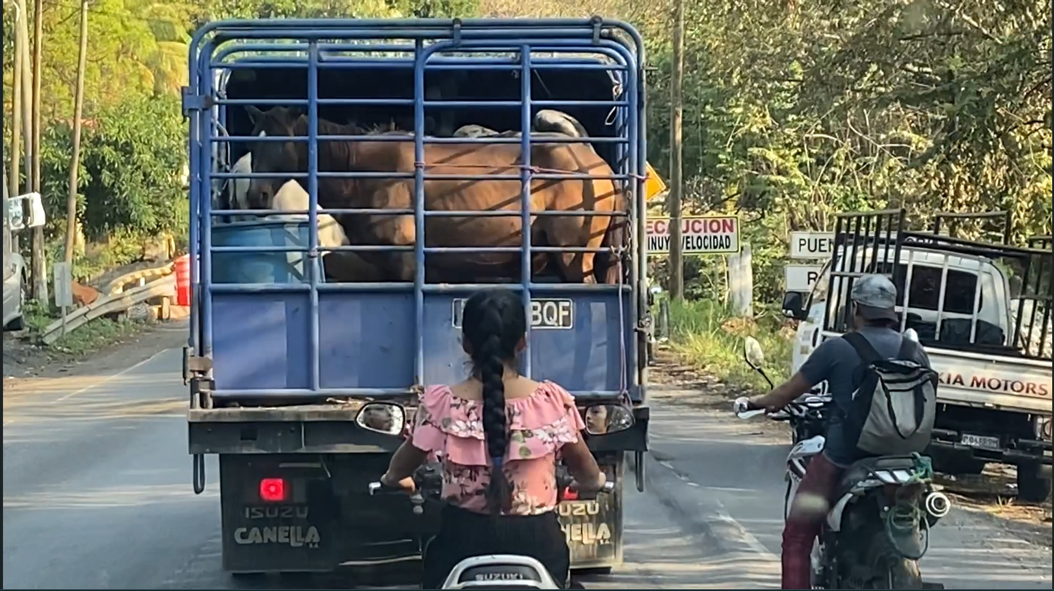
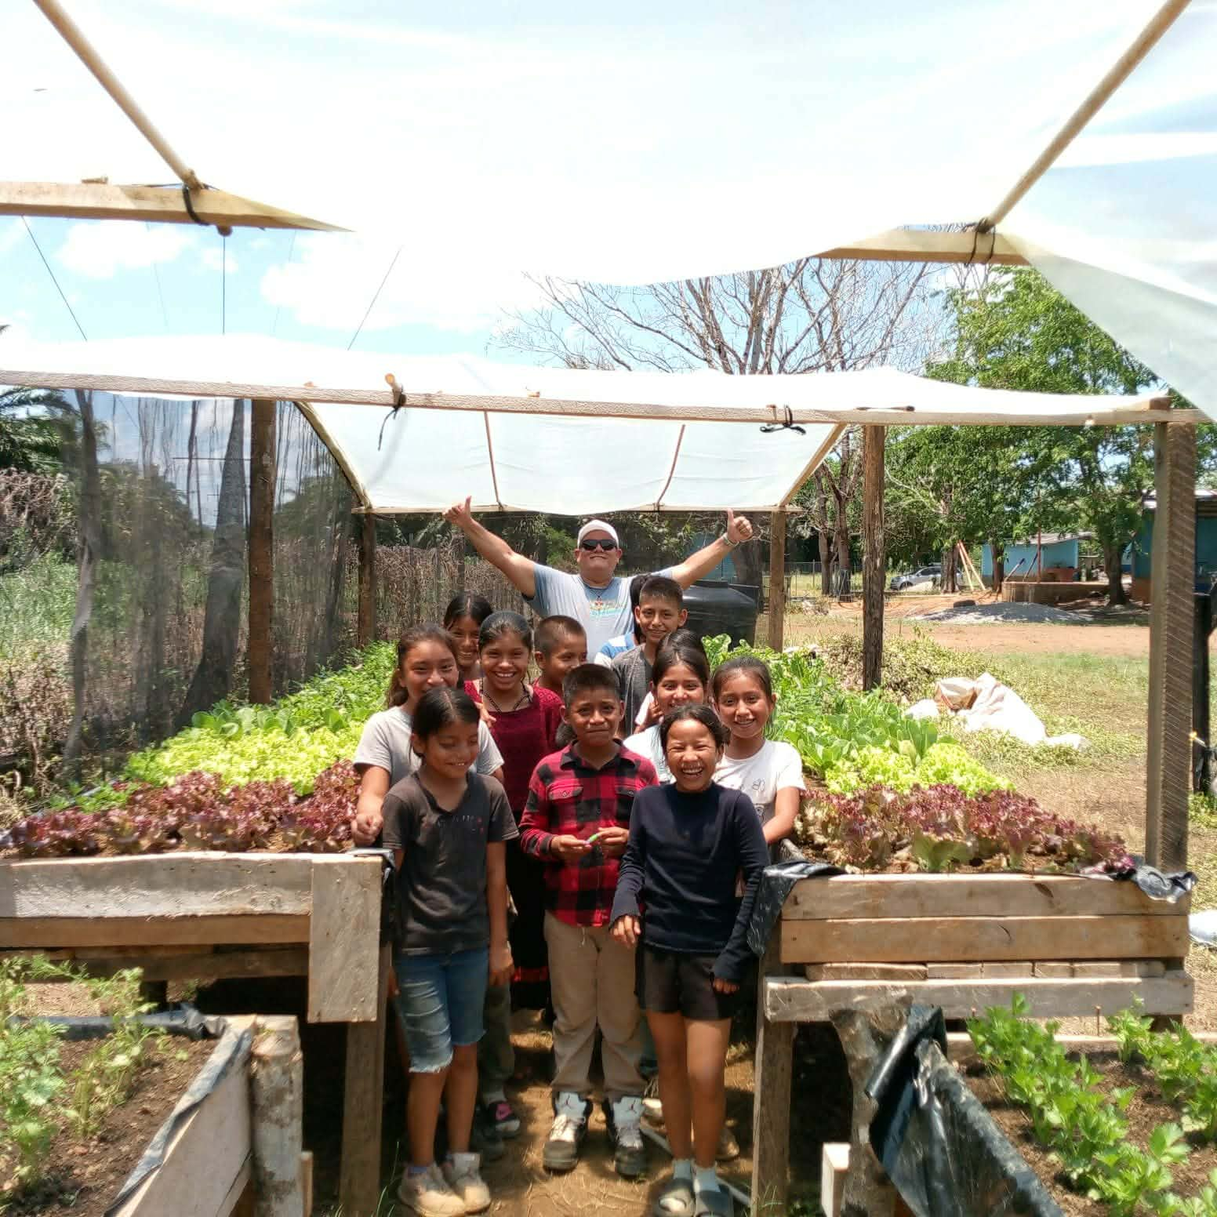
Day 4
September 25
Transfer from Río Dulce to Fray Bartolomé de las Casas
3-hour transfer
WORKDAY #2
Transfer from Fray Bartolomé de las Casas to Río Dulce
3-hour transfer
Hotel Viña del Lago
Includes:
Breakfast in Fray Bartolome de Las Casas and
lunch in Bolonco
Dinner at Finca Tijax

Slide 8
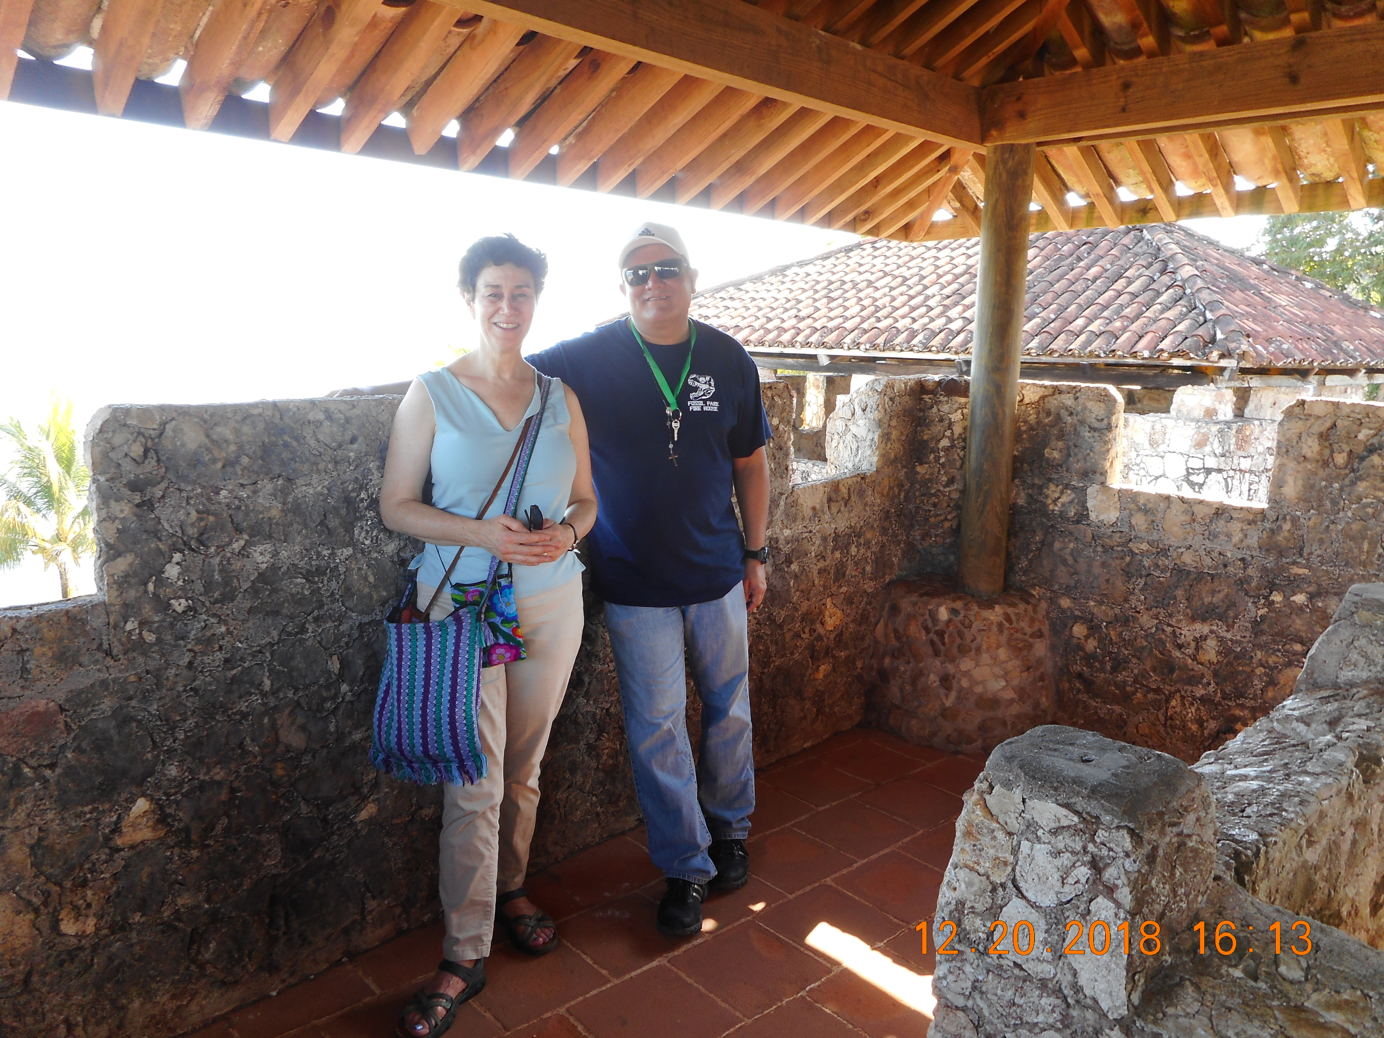
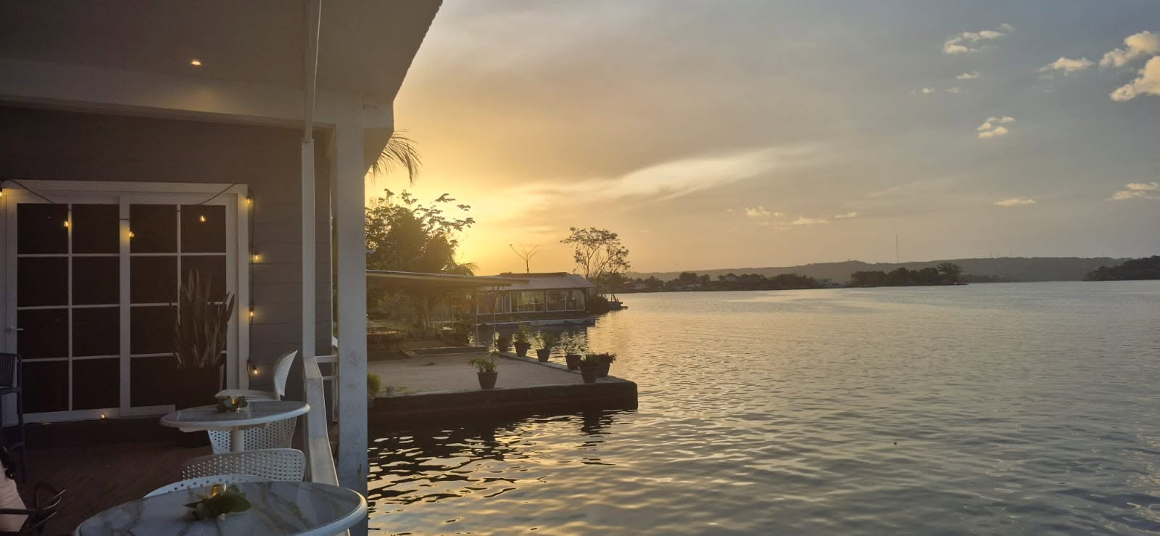
Day 5
September 26
Tour in Castillo de San Felipe de Lara
After the Tour we start the transfer to Flores
6 hours transfer with lunch time included
Hotel La Casona del Lago
Includes:
Breakfast in Viña del Lago, Lunch in
Finca Ixobel, Poptún, and Dinner at Casona del Lago

Slide 9
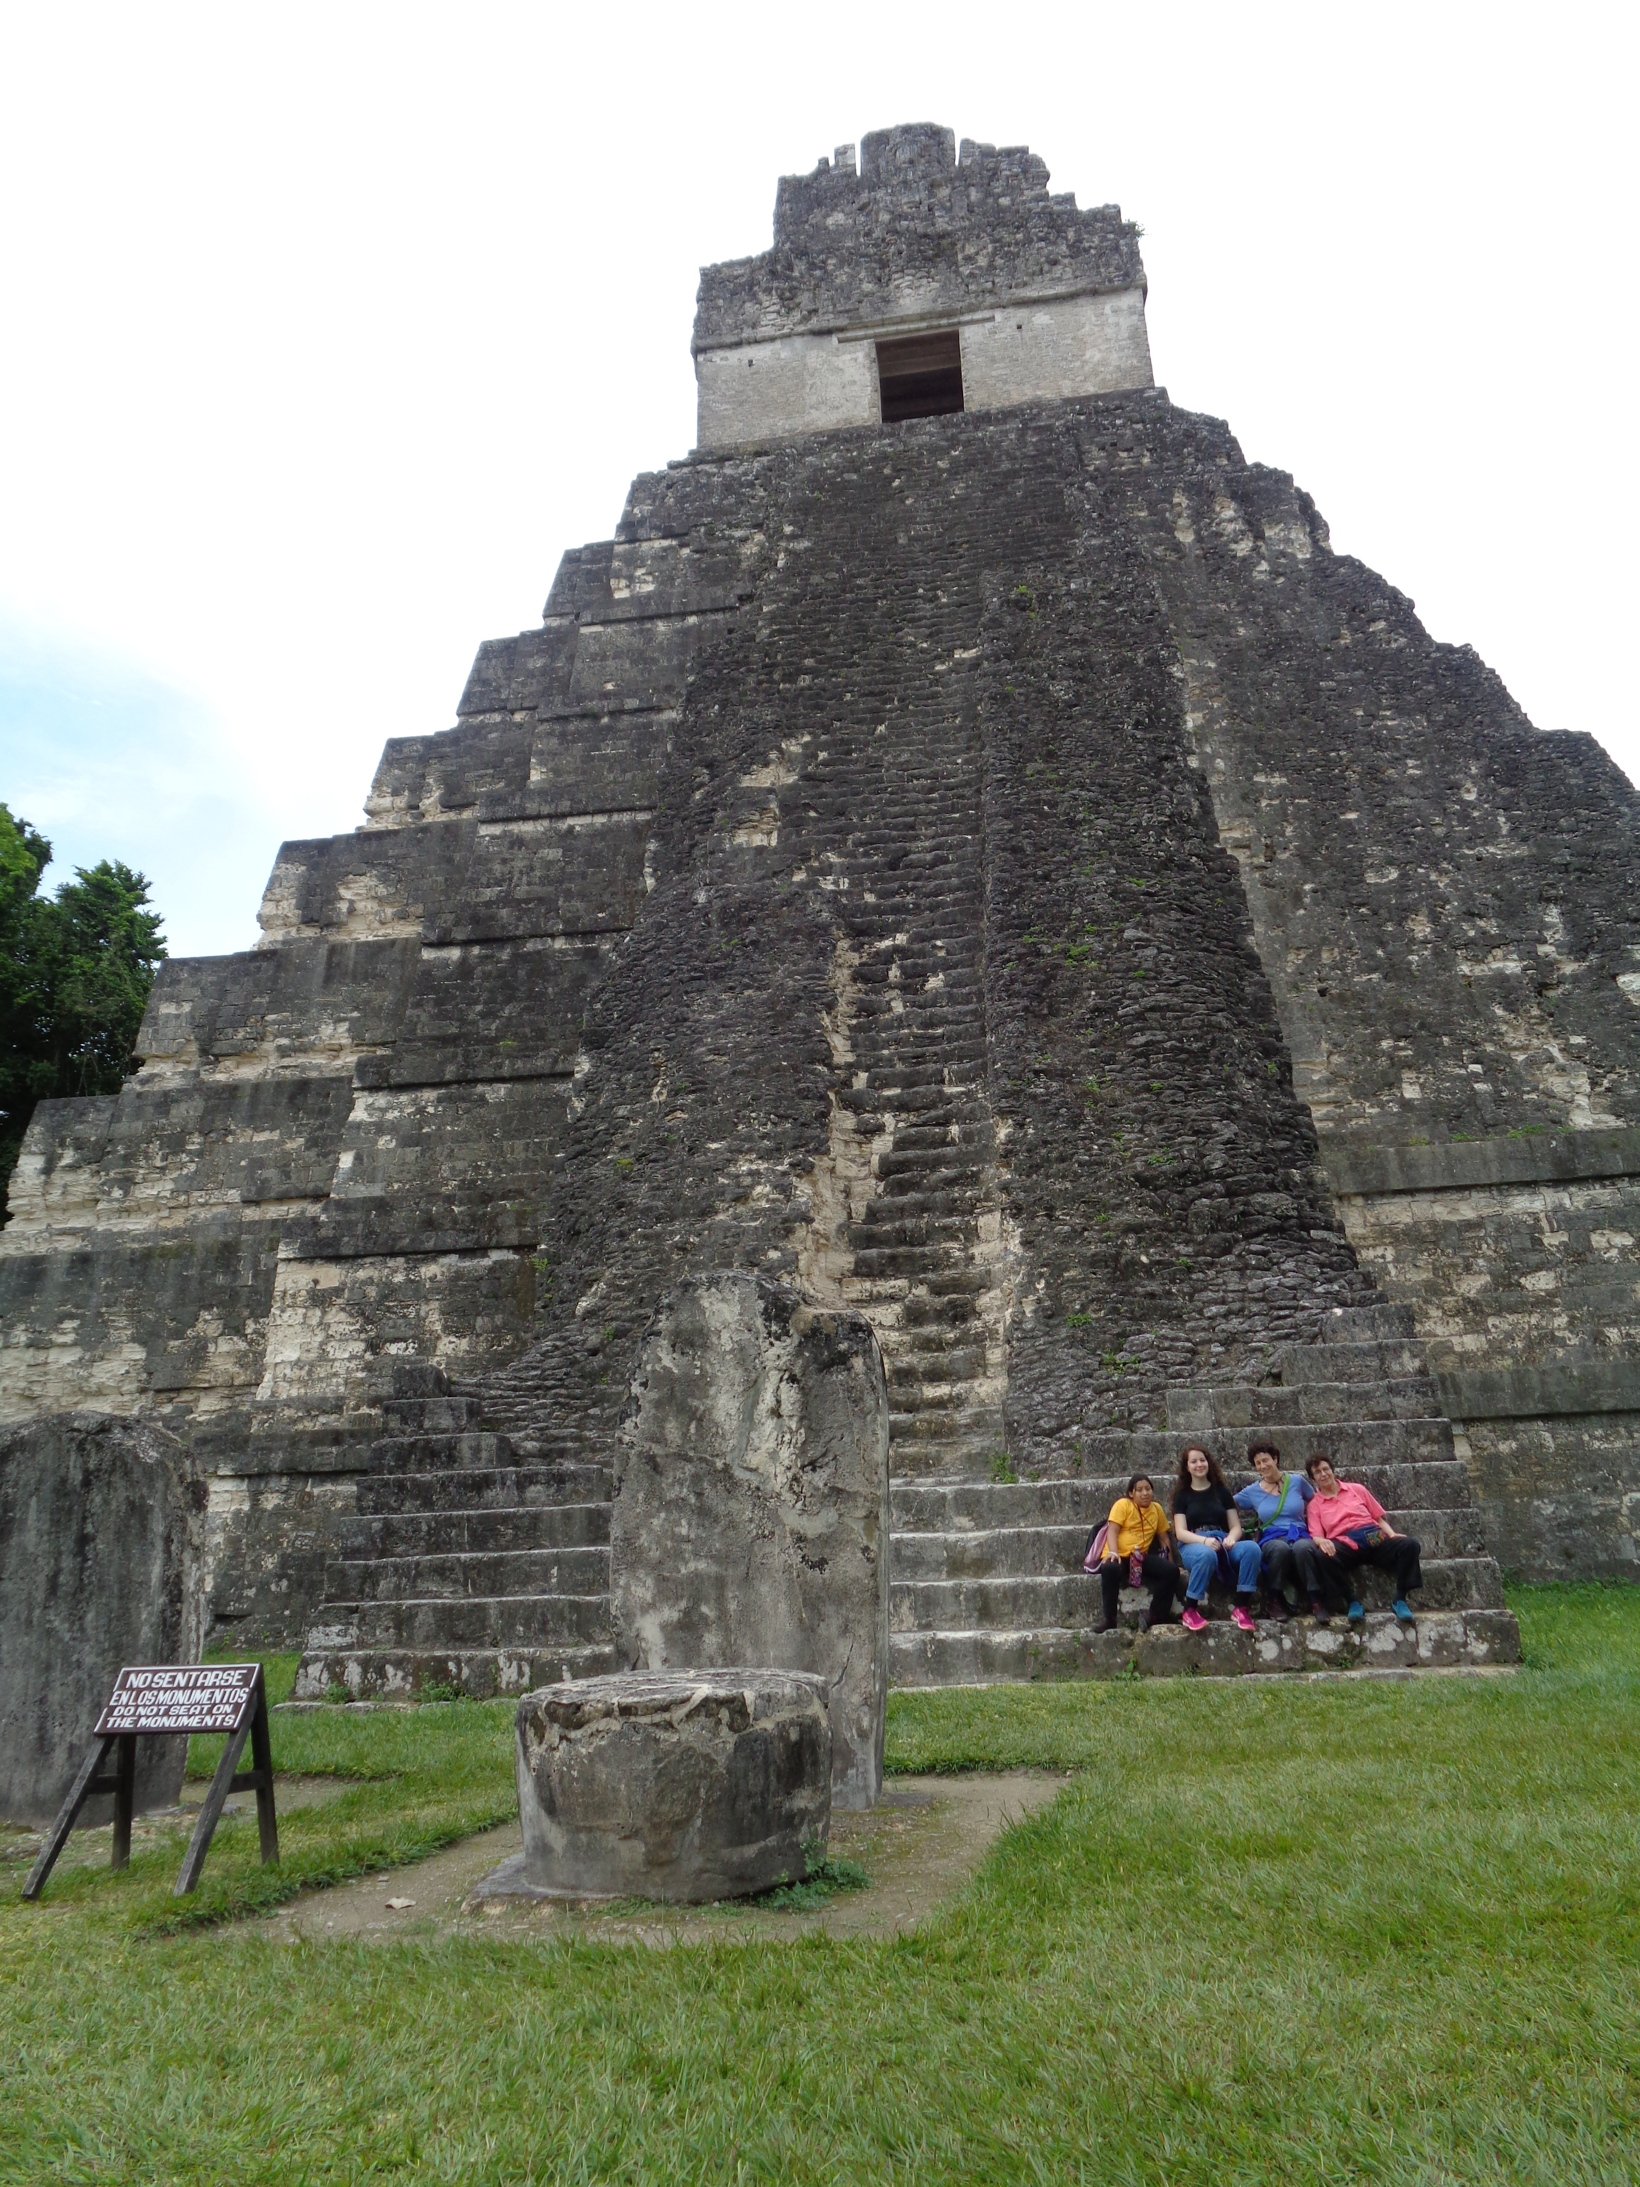
Day 6
September 27
Tour to TIKAL
Prepare to spend the morning in the most important Mayan site in Guatemala.
Hotel La Casona del Lago
Includes:
Breakfast at Casona del Lago, Lunch in Hotel Las Gardenias in el Remate, Dinner at Casona del Lago

Slide 10

Day 7
September 28
Flight from Flores to Guatemala City
1 hour
Flight Out of Guatemala Back to the U.S.
Goodbye Guatemala!
See you soon!

Slide 11
Group of 9
Per person price:
$1,800 P/P
Because space is limited, please reply
by August 25, 2026, to: info@sowingops.org for further information and to book your registration!

Slide 12
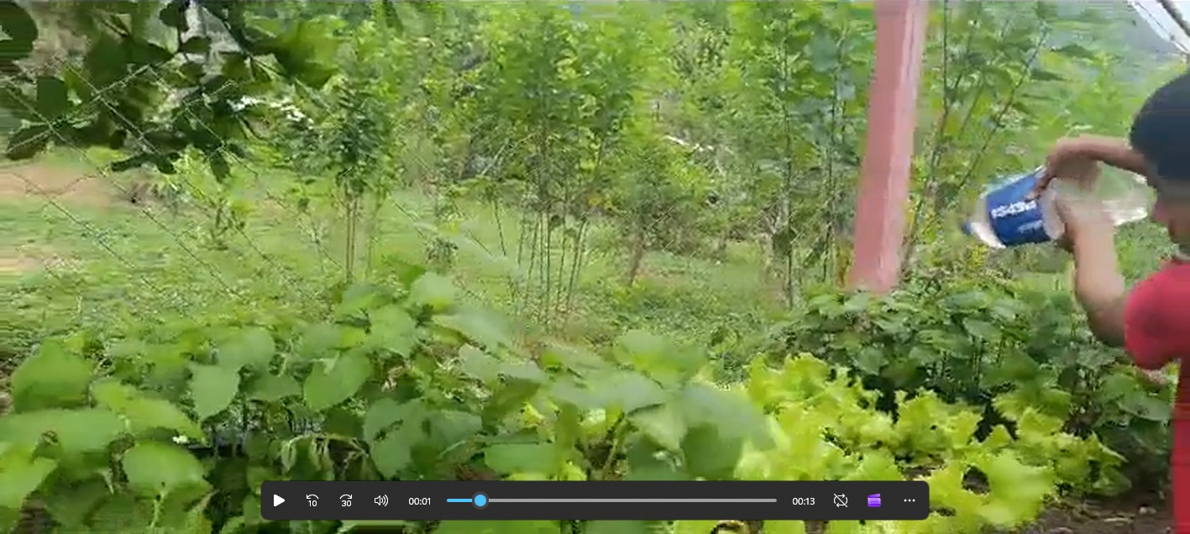
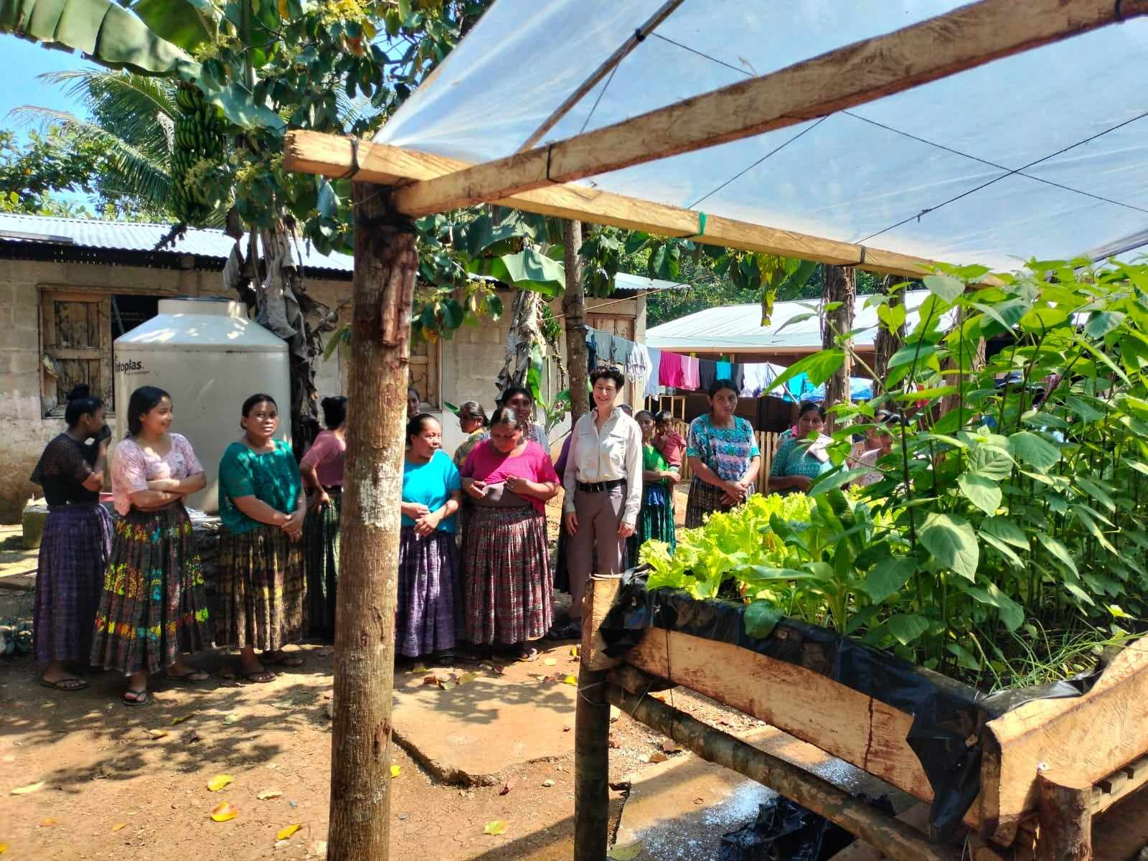
The price includes meals, hotels, transportation, internal plane tickets, and a $425 donation to Sowing Opportunities to be part of our mission of building agricultural capacity, resources, and leadership in remote indigenous villages and public primary schools in Guatemala.

